Slide 1
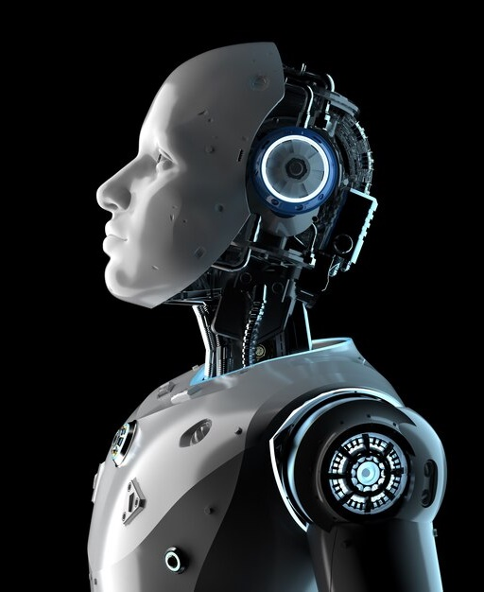
Automation Using Robotics
Module 4

Slide 2
Introduction
Robotics is a multidisciplinary field that involves the design, construction, programming, and operation of autonomous or semi-autonomous machines, known as robots, to perform tasks in the physical world.
Scope and Purpose
Involves design, construction, and control of robots.
Focus on sensory feedback and information processing.
Technologies aimed at replacing humans in various activities.

Slide 3

Types of Robots
Articulated: The feature of this robot is its rotary joints and range of these are from 2 to 10 or more joints. The arm is connected to the rotary joint and each joint is known as the axis which provides a range of movements.
Cartesian: These are also known as gantry robots. These have three joints which use the Cartesian coordinate system i.e x, y, z. These robots are provided with attached wrists to provide rotatory motion.
Cylindrical: These types of robots have at least one rotatory joints and one prismatic joint which are used to connect the links. The use of rotatory joints is to rotate along the axis and prismatic joint used to provide linear motion.
Polar: These are also known as spherical robots. The arm is connected to base with a twisting joint and have a combination of 2 rotatory joint and one linear joint.
Scara: These robots are mainly used in assembly applications. Its arm is in cylindrical in design. It has two parallel joints which are used to provide compliance in one selected plane.
Delta: The structure of these robots are like spider-shaped. They are built by joint parallelograms that are connected to the common base. The parallelogram moves in a dome-shaped work area. These are mainly used in food and electrical industries.

Slide 4
Components of Robots
01.
02.
03.
04.
Sensors
Actuators
Control System
Power Supply
Devices to perceive and collect information from the environment.
Examples: cameras, ultrasonic sensors, gyroscopes.
Mechanisms responsible for movement and manipulation.
Examples: motors, servos, hydraulic systems.
Governs the robot's behavior and responses. Includes software and hardware components.
Provides energy to operate the robot. Can be batteries, electric power, or a combination.

Slide 5
Components of Robots
05.
06.
07.
08.
End Effector
Manipulator
Communication Device
Controller
The tool or device at the robot's extremity performing tasks. Examples: grippers, welding tools, cutting tools.
Mechanical arm or limb responsible for movement and interaction. Consists of joints and links.
Enable interaction with external systems or users.Examples: Wi-Fi modules, Bluetooth, communication ports.
Brain of the robot, processing and executing commands. Can be embedded or external.

Slide 6
Components of Robots
09.
10.
11.
12.
Frame or Chassis
Feedback System
Programming Interface
Safety Features
The physical structure supporting and connecting components.Provides stability and defines the robot's shape.
Mechanism for the robot to receive information about its own state.Helps in adjusting actions based on external conditions.
Allows humans to input commands and program the robot. Can be graphical interfaces or programming languages.
Systems to ensure safe operation and prevent accidents. Examples: emergency stop buttons, collision detection.

Slide 7
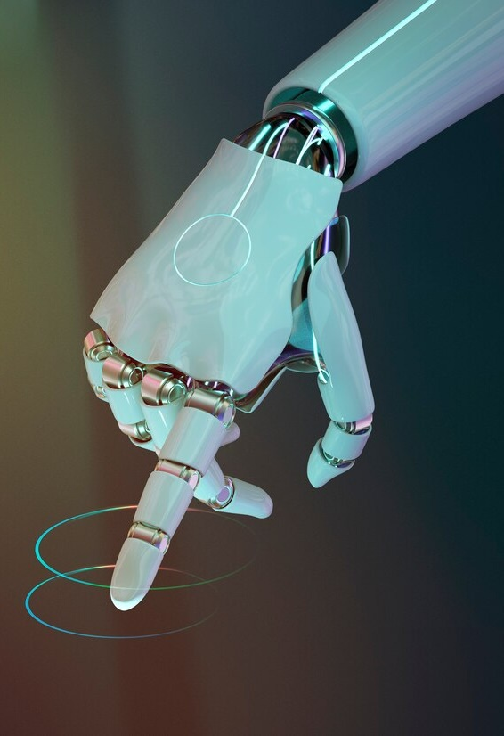
Robot Control Systems
Open-Loop Control: Executes pre-programmed commands without feedback.
Closed-Loop Control: Adjusts actions based on real-time feedback for precision.
PID Control: Uses proportional, integral, and derivative terms for stability.
Adaptive Control: Adjusts parameters to adapt to changes in the environment.
Hybrid Control Systems: Combines open-loop and closed-loop elements for flexibility.
Force Control: Regulates force during interactions, useful for delicate tasks.
Motion Control: Focuses on regulating robot movement, including trajectory planning.
Behavior-Based Control: Modular approach, combining behavior modules for complex actions.
AI and ML Control: Uses AI and machine learning for learning and adaptation.
Hierarchical Control: Organizes control levels in a hierarchy for flexibility and scalability.
01

Slide 8

Industrial Robot Applications
Industrial robots are widely used in various applications across manufacturing and production processes to improve efficiency, precision, and overall productivity. Here are some common industrial robot applications:
Welding: Industrial robots are used for welding tasks in automotive, aerospace, and construction industries. They ensure consistent weld quality and increased speed.
Assembly: Robots perform intricate assembly tasks, such as putting together electronic components, attaching parts in automotive manufacturing, or assembling consumer goods.
Painting: Automated painting systems in industries like automotive use robots to ensure uniform and precise application of paint, reducing waste and improving finish quality.
Material Handling: Robots are employed for loading, unloading, and transferring materials in warehouses, factories, and logistics operations, enhancing efficiency and reducing manual labor.
Palletizing: Robots are utilized for stacking and organizing products on pallets in warehouses and distribution centers, streamlining the packaging process.
Machine Tending: Robots handle tasks related to machine operation, such as loading and unloading parts from CNC machines, injection molding machines, or other manufacturing equipment.

Slide 9

Industrial Robot Applications
Packaging: Industrial robots are used for packaging products, including picking, placing, and sealing items in boxes, optimizing the packaging process.
Quality Inspection: Robots equipped with vision systems inspect products for defects, ensuring quality control and reducing the likelihood of faulty items reaching consumers.
CNC Machining: Robots assist in Computer Numerical Control (CNC) machining tasks, performing precise cutting, milling, and shaping of materials.
Glass Handling: In the glass manufacturing industry, robots handle delicate glass pieces for cutting, shaping, and assembling, improving efficiency and reducing breakage.
Pick and Place: Robots excel at picking items from one location and placing them in another, a fundamental task in various manufacturing and logistics processes.
Deburring and Polishing: Robots automate the deburring and polishing of metal or plastic components, ensuring a smooth finish and maintaining consistent quality.
Material Removal: Industrial robots are used for tasks like grinding, milling, or cutting excess material from workpieces, contributing to precision and efficiency.
3D Printing: In additive manufacturing, robots are employed for 3D printing tasks, layering materials to create complex components.

Slide 10
Repeatability
Repeatability can be defined as the closeness of agreement between several positions reached by the robot’s end-effector for the same controlled position, repeated several times under the same conditions. Geometrically, the position repeatability can be defined as the radius of the smallest sphere that encompasses all the positions reached for the same requested position.
Robotic Accuracy & Repeatability
<>
<>
Accuracy
The absolute position accuracy is the ability of the robot to reach a specific programmed position with a minimum of error. Note that here we use the word absolute to refer to the fact that the position accuracy is evaluated with respect to a unique reference frame, mainly the work reference frame (or the world reference frame). Often these are arbitrary frames of reference used specifically to measure the variations in position accuracy. To assess the static accuracy of the robot movement, the position measurements are carried out after a complete stop of the end-effector’s movement (regardless of the path taken to reach the desired position) from the previous pose of the end-effector.

Slide 11
Use 1
Use 3
Industrial Robotics: Used in manufacturing for tasks like welding, assembly, and painting.
Medical Robotics: Applied in surgeries, rehabilitation, and healthcare.
Military and Defense Robotics: Used for surveillance, reconnaissance, and bomb disposal.
Educational Robotics Designed for teaching programming and engineering.
<>
<>
<>
Types of Robotics
Use 2
Autonomous Vehicles: Includes self-driving cars, drones, and UAVs.
Service Robotics: Assists humans in various roles (e.g., cleaning, delivery).
Humanoid Robotics: Mimics human form and tasks

Slide 12
Use 5
Soft Robotics: Involves robots with soft and flexible materials.
Swarm Robotics: Involves multiple robots collaborating for a common goal.
Exoskeletons: Wearable robotic devices to enhance human capabilities
Types of Robotics
<>
<>
Use 4
Agricultural Robotics: Used in farming for tasks like harvesting and precision agriculture.
Telepresence Robotics: Enables remote interaction with environments.
Research and Exploration Robotics: Utilized in scientific research and exploration.

Slide 13


Various Generations of Robots
First Generation (1950s-1970s):
Characteristics:
Simple mechanical devices
Limited computational capabilities.
Mainly used in industrial automation for repetitive tasks.
Examples: Unimate, the first industrial robot used for assembly line tasks.
Second Generation (1980s 2000s):
Characteristics:
Introduction of microprocessors and sensors.
Improved accuracy and flexibility.
Expanded use in manufacturing and industrial settings.
Examples:Robots with more advanced programming capabilities.

Slide 14
Various Generations of Robots
Third Generation (2000s-Present):
Fourth Generation (Emerging/Current):
Fifth Generation (Potential Future):
Expected Characteristics:
Highly intelligent and adaptive robots.
Advanced emotional intelligence and understanding.
Integration with other emerging technologies like quantum computing.
Potential Examples:
Robots with human-like cognitive abilities, highly versatile and capable of complex decision-making.
Characteristics:
Advanced sensors, vision systems, and artificial intelligence.
Greater adaptability and autonomy.
Widespread use in various industries beyond manufacturing.
Examples:
Surgical robots, autonomous vehicles, sophisticated service robots.
Characteristics:
Integration of advanced AI, machine learning, and natural language processing.
Enhanced collaboration between humans and robots.
Focus on human-robot interaction and cognitive capabilities.
Examples:
AI-powered service robots, collaborative robots (cobots), advanced humanoid robots.

